Slide 1

Meghnad Saha Institute of Technology
Department of IT

Slide 2
Topic: A Comprehensive Study on IoT and GPS Based
Accident Detection Systems for Smart Vehicles
Team Member Details:
Soumyadeep Das
soumyadeep_d.it2021@msit.edu.in
Debjit Das
debjit_d.it2021@msit.edu.in
Avilash Bhowmick
Avilash_b.it2021@msit.edu.in
Tanushree Mondal
tanushree_m.it2021@msit.edu.in
Meghnad Saha Institute of Technology
Department of IT

Slide 3
Meghnad Saha Institute of Technology
Department of IT
Objective
“Smart Car Accident Detection” is an IOT and GPS based model designed to enhance vehicle safety and prevent accidents, integrating live location tracking.

Slide 4
Meghnad Saha Institute of Technology
Department of IT
Objective
“Smart Car Accident Detection” is an IOT and GPS based model designed to enhance vehicle safety and prevent accidents, integrating live location tracking.
Topics To be Presented

Slide 5

Meghnad Saha Institute of Technology
Department of IT
Objective
“Smart Car Accident Detection” is an IOT and GPS based model designed to enhance vehicle safety and prevent accidents, integrating live location tracking.
Topics To be Presented
1
Key Components

Slide 6

Meghnad Saha Institute of Technology
Department of IT
Objective
“Smart Car Accident Detection” is an IOT and GPS based model designed to enhance vehicle safety and prevent accidents, integrating live location tracking.
Topics To be Presented
Key Components
1
2
Sensor Integration and Data Acquisition

Slide 7

Meghnad Saha Institute of Technology
Department of IT
Objective
“Smart Car Accident Detection” is an IOT and GPS based model designed to enhance vehicle safety and prevent accidents, integrating live location tracking.
Topics To be Presented
Key Components
1
Sensor Integration and Data Acquisition
2
3
Real Time Monitoring and Notification

Slide 8

Meghnad Saha Institute of Technology
Department of IT
Objective
“Smart Car Accident Detection” is an IOT and GPS based model designed to enhance vehicle safety and prevent accidents, integrating live location tracking.
Topics To be Presented
Key Components
1
Sensor Integration and Data Acquisition
2
Real Time Monitoring and Notification
3
4
5
Deployment and Consideration

Slide 9

Meghnad Saha Institute of Technology
Department of IT
Objective
“Smart Car Accident Detection” is an IOT and GPS based model designed to enhance vehicle safety and prevent accidents, integrating live location tracking.
Topics To be Presented
Key Components
1
Sensor Integration and Data Acquisition
2
Real Time Monitoring and Notification
3
4
Deployment and Consideration
5
6
Future Development

Slide 10
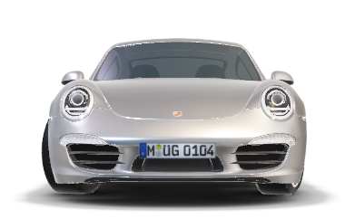
Meghnad Saha Institute of Technology
Department of IT
Objective
“Smart Car Accident Detection” is an IOT and GPS based model designed to enhance vehicle safety and prevent accidents, integrating live location tracking.
Topics To be Presented
Key Components
1
Sensor Integration and Data Acquisition
2
Real Time Monitoring and Notification
3
4
Deployment and Consideration
Future Development
5

Slide 11
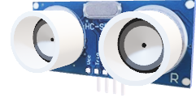
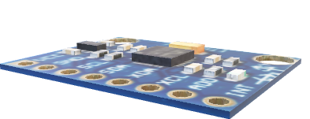
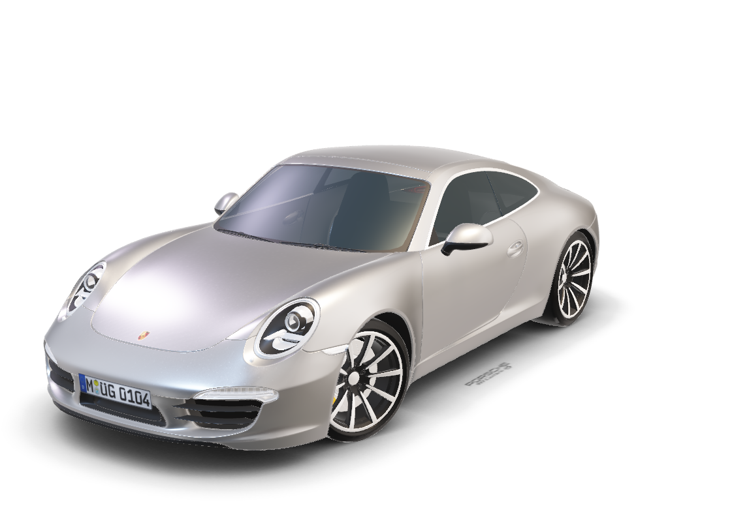
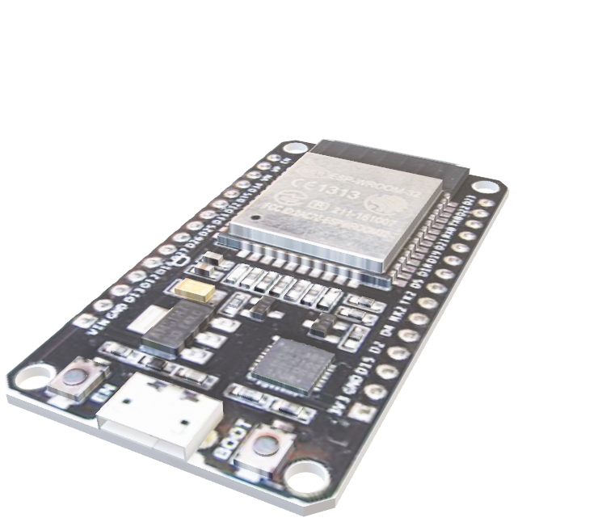
Meghnad Saha Institute of Technology
Department of IT
Ultrasound HCSR04
GYRO MPU 6050
ESP32
GPS Ublox Neo6m
Key Components
Firebase

Slide 12
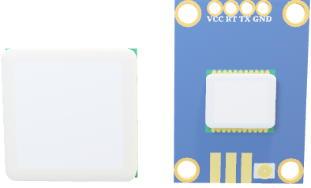
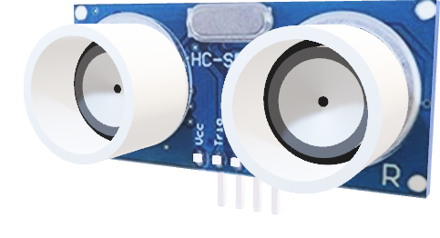
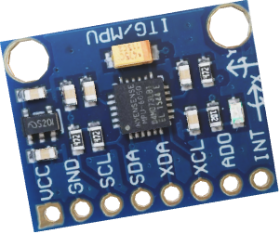
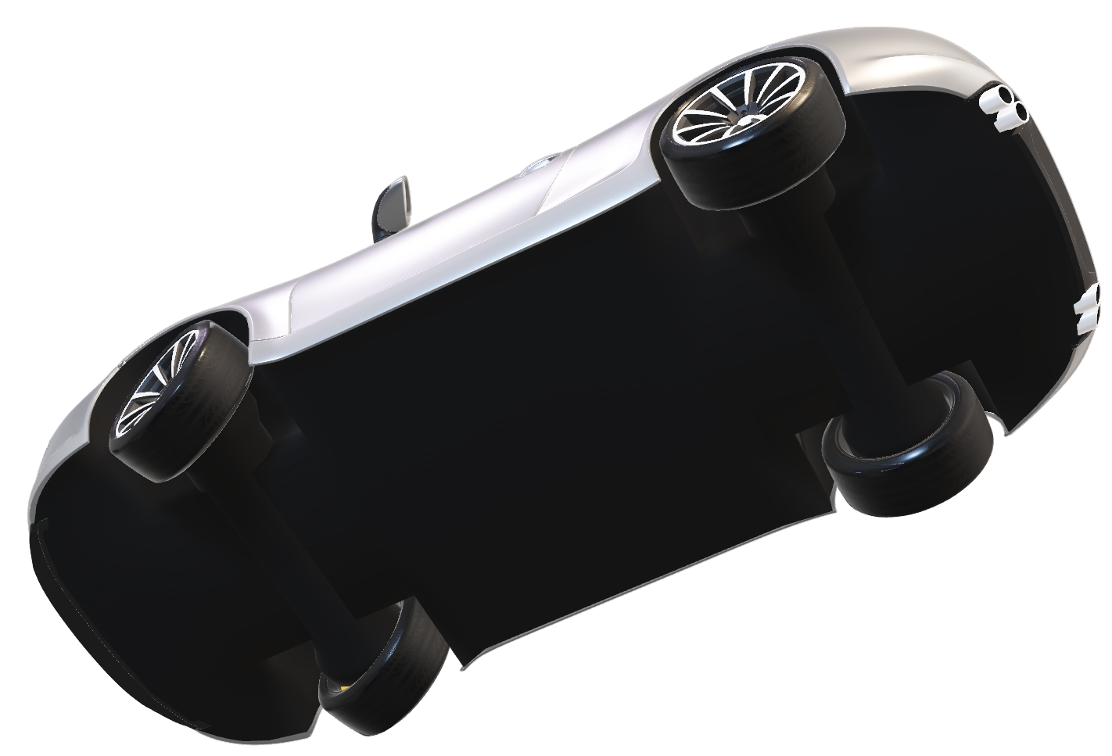
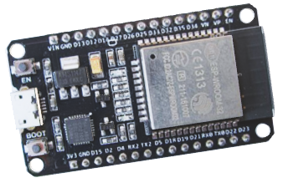
Meghnad Saha Institute of Technology
Department of IT
Ultrasound HCSR04
GPS Ublox Neo6m
Key Components
ESP32
A feature-rich SoC with integrated Wi-Fi and Bluetooth connectivity for a wide-range of IoT applications.
Firebase
GYRO MPU 6050
a three-axis accelerometer and three-axis gyroscope Micro Electro-mechanical system (MEMS)

Slide 13
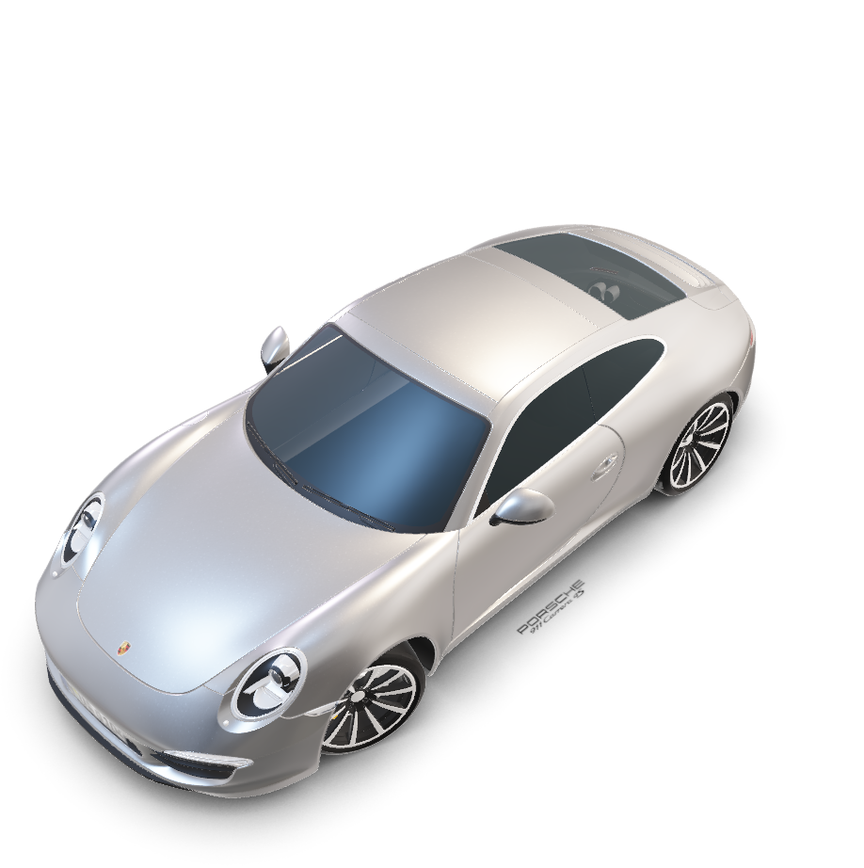
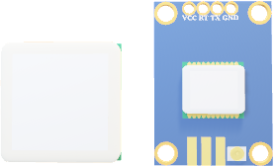
Meghnad Saha Institute of Technology
Firebase
Department of IT
Key Components
ESP32
Ultrasound HCSR04
GYRO MPU 6050
GPS Neo6m
a well-performing complete GPS receiver with a built-in 25 x 25 x 4mm ceramic antenna, which provides a strong satellite search capability.

Slide 14
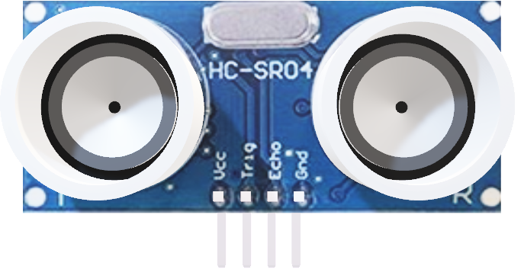
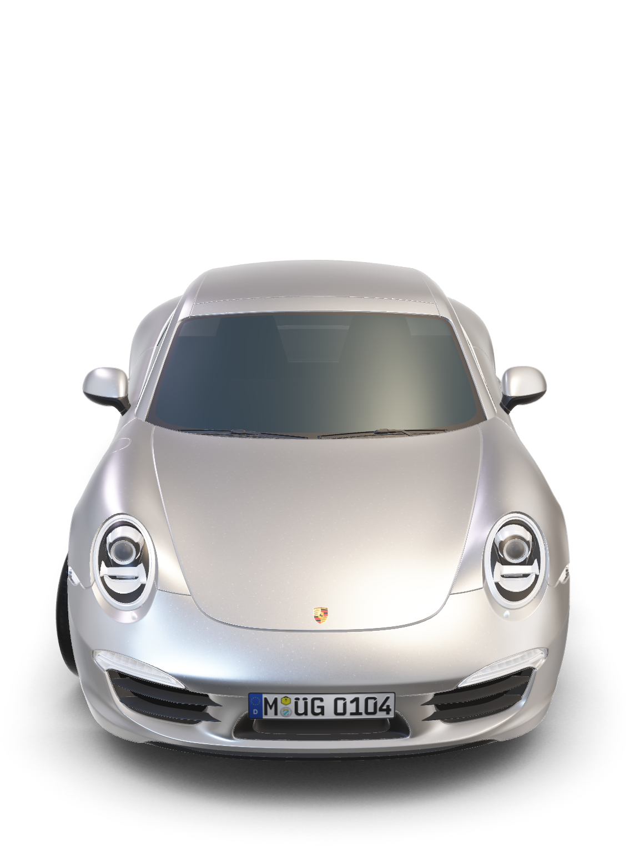
Meghnad Saha Institute of Technology
Firebase
Department of IT
Key Components
ESP32
GYRO MPU 6050
GPS Neo6m
Ultrasound HCSR04
Ultrasonic
non-contact distance measurement sensor

Slide 15
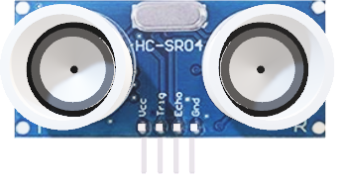
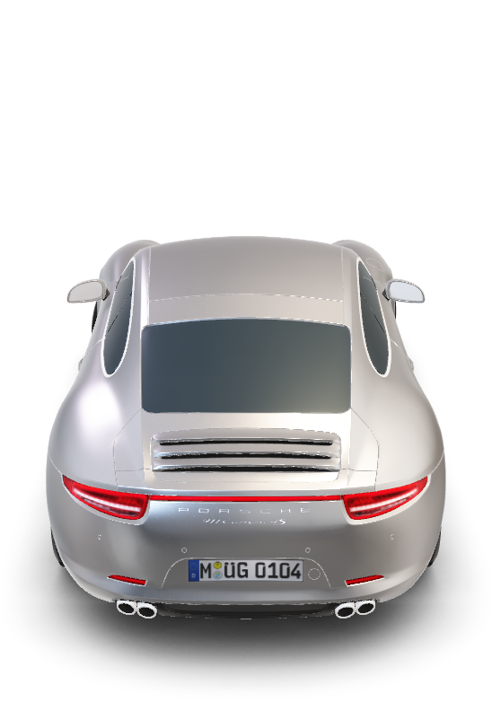
Meghnad Saha Institute of Technology
Firebase
Department of IT
Key Components
ESP32
GYRO MPU 6050
GPS Neo6m
Ultrasound HCSR04
Ultrasonic
non-contact distance measurement sensor

Slide 16
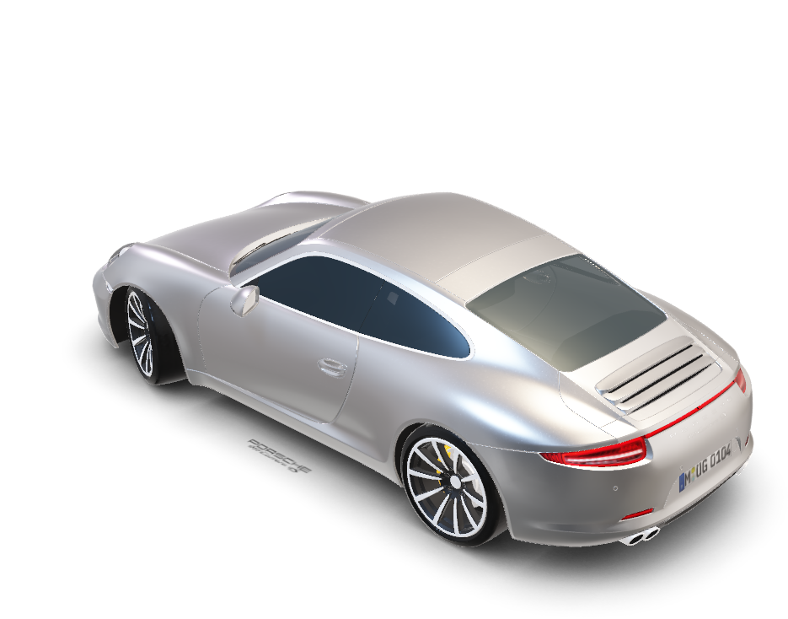
Meghnad Saha Institute of Technology
Department of IT
Key Components
ESP32
GYRO MPU 6050
GPS Neo6m
Ultrasound HCSR04
Sensor Integration and Data Acquisition

Slide 17

Meghnad Saha Institute of Technology
Department of IT
Sensor Integration and Data Acquisition

Slide 18
Meghnad Saha Institute of Technology
Department of IT
Sensor Integration and Data Acquisition
Sensor Interfacing
Connecting and configuring the sensors to the ESP32
Data Aggregation
Collecting sensor data in real-time for analysis

Slide 19
Meghnad Saha Institute of Technology
Department of IT
Sensor Interfacing

Slide 20
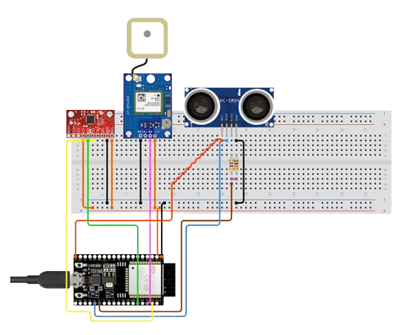
Meghnad Saha Institute of Technology
Department of IT
Sensor Interfacing

Slide 21

Meghnad Saha Institute of Technology
Department of IT
Data Aggregation

Slide 22
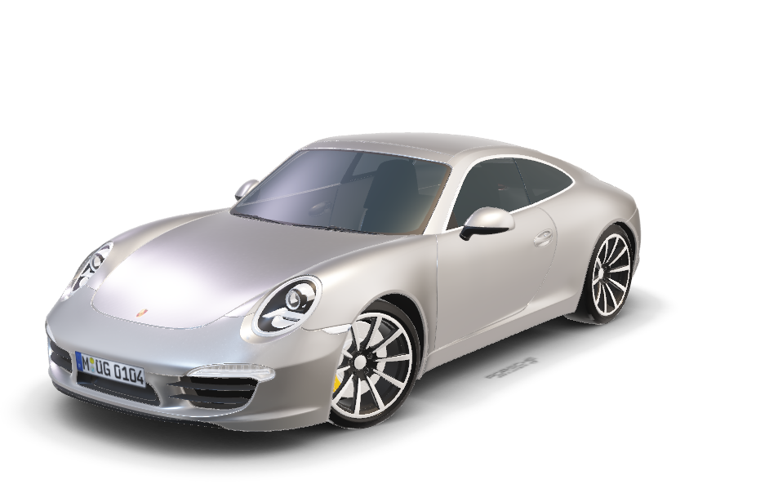
Meghnad Saha Institute of Technology
Department of IT
Data Aggregation

Slide 23


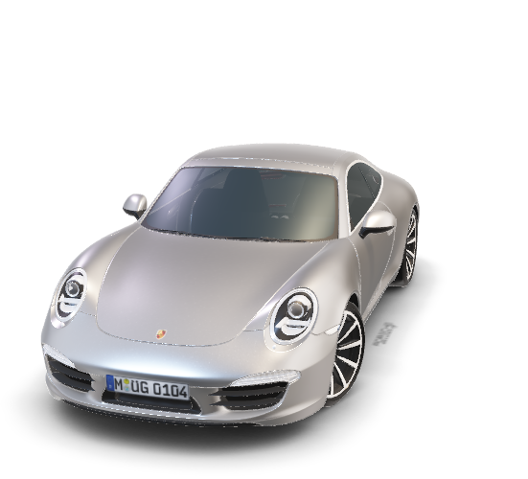
Meghnad Saha Institute of Technology
Department of IT
Data Aggregation

Slide 24
Meghnad Saha Institute of Technology
Department of IT
Realtime Monitoring and Notification

Slide 25




Meghnad Saha Institute of Technology
Department of IT
Realtime Monitoring and Notification
Instant alerts
Geolocation
Vehicle Status
Mobile Accessibility
Notify Emergency Contacts
Provides Accurate Location Data of the Vehicle
Monitor Vehicle diagnostics and driver conditions
Enable real-time monitoring and control through apps

Slide 26
Meghnad Saha Institute of Technology
Department of IT
Deployment and Consideration

Slide 27




Meghnad Saha Institute of Technology
Department of IT
Deployment and Consideration
Hardware Integration
Power Management
Seamless Integration of sensors and microcontrollers
Ensuring reliable and efficient power supply
Data Privacy
Maintenance and Update
Secure Data Handling and user privacy protocol
Ongoing System Monitoring and Software Update
Future Development

Slide 28
Meghnad Saha Institute of Technology
Department of IT
Future Development

Slide 29
Meghnad Saha Institute of Technology
Department of IT
Future Development
Driver Behavior Analysis | Drowsiness detection, Alcohol content monitoring, Distraction detection.
Traffic Signal Analysis | Monitoring the traffic signal and controlling the car according to that can also be included.
AI Predictive Analysis | Leveraging machine learning for proactive accident prevention
Autonomous Response | Automatic intervention and evasive maneuvers in emergencies
Emergency Support | Integrate all of the hospitals database of a city and use that as a medical support for the accident.

Slide 30
Thank You
Meghnad Saha Institute of Technology
Department of IT

